Slide 1


By An Nguyen, Zohaib Hashmi, Darren Kim, Rakhi Roy, Snehitha Soma, Anjana Bandara

Slide 2
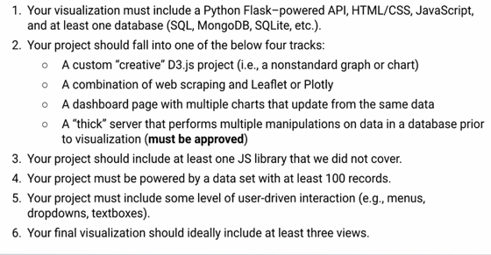
Project requirement

Slide 3


Data sources
https://www.kaggle.com/shivamb/netflix-shows
https://developers.google.com/public-data/docs/canonical/countries_csv

Slide 4
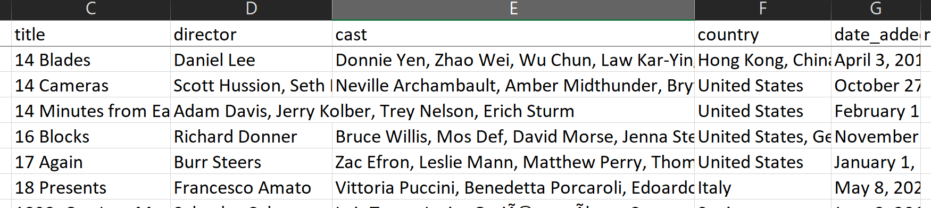
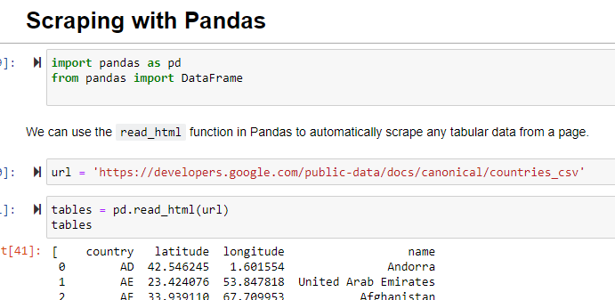
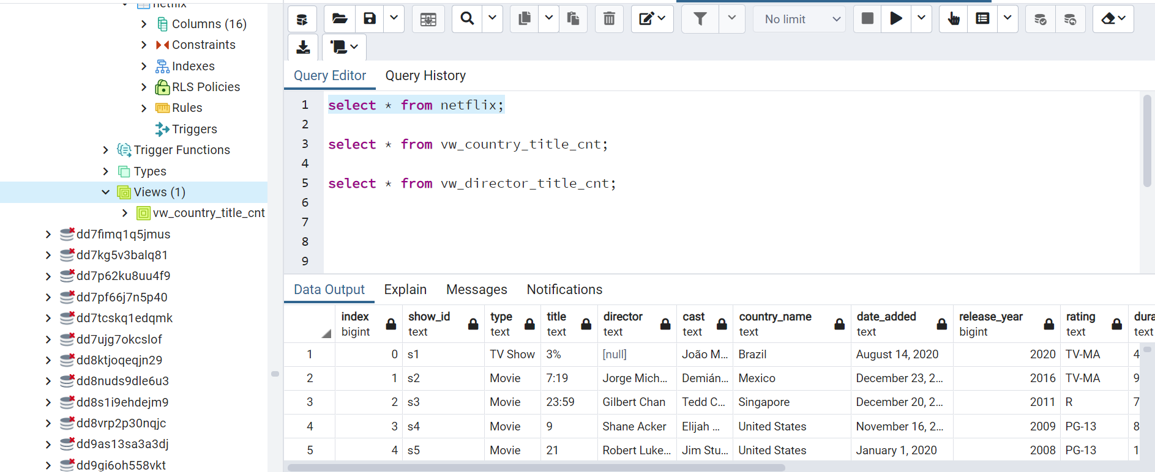

Cleaning and Grouping using Pandas and a Jupyter Notebook.

Slide 5



SERVER END
PostgreSQL to create DB
We used Heroku to deploy our app and linked it to our Github repository.
Flask is used to build our web application.

Slide 6
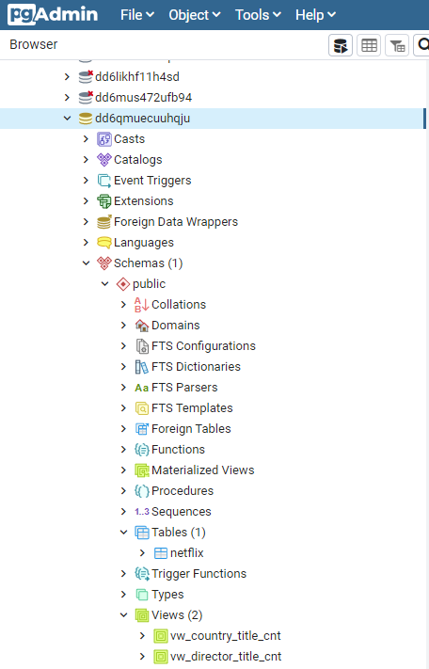
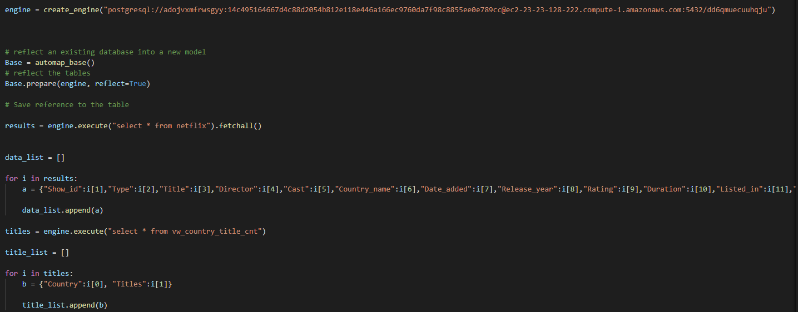
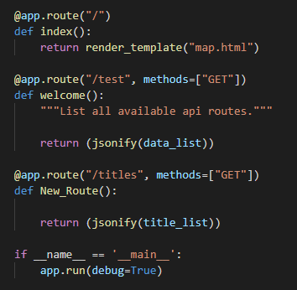
https://netflix-monash.herokuapp.com/

Slide 7
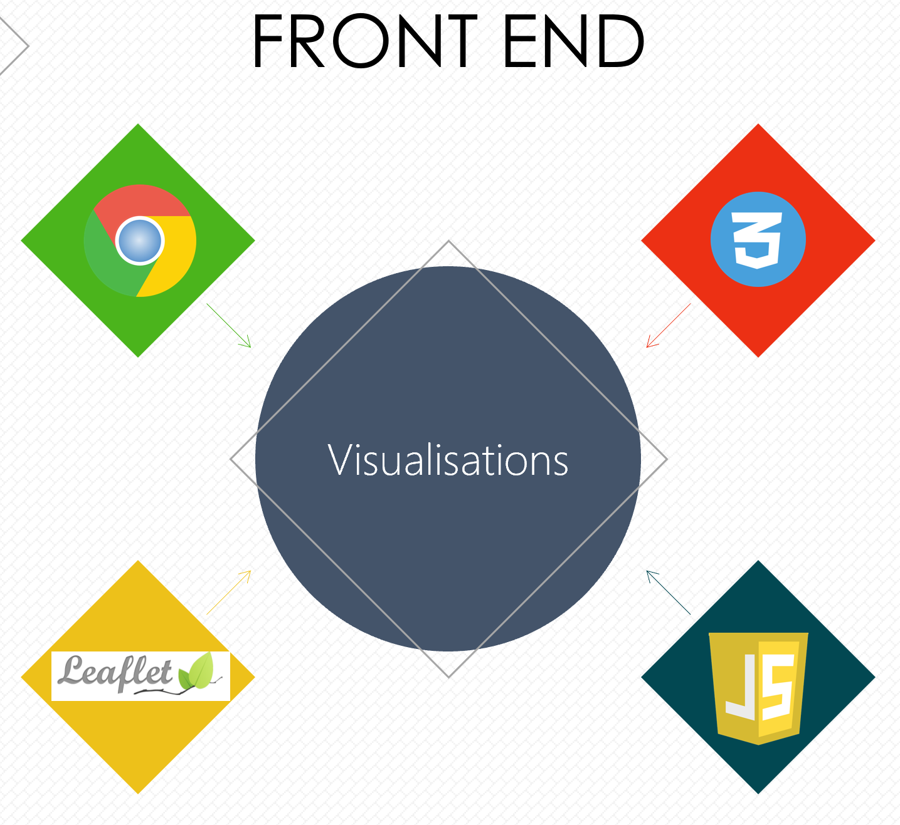

HTML for
browser access
CSS for style
Mapbox GL JS
JavaScript

Slide 8
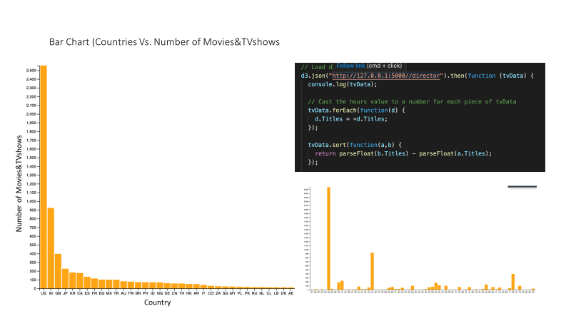

Slide 9
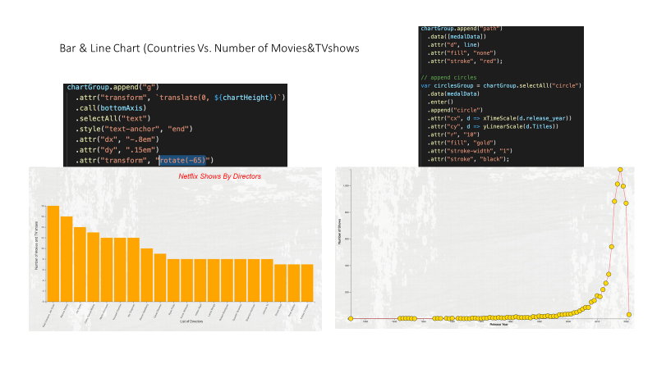

Slide 10

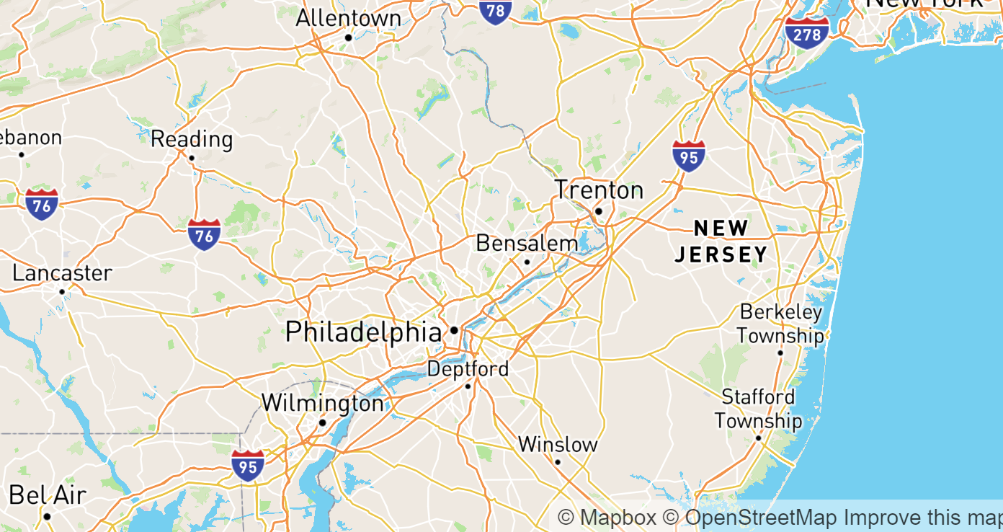
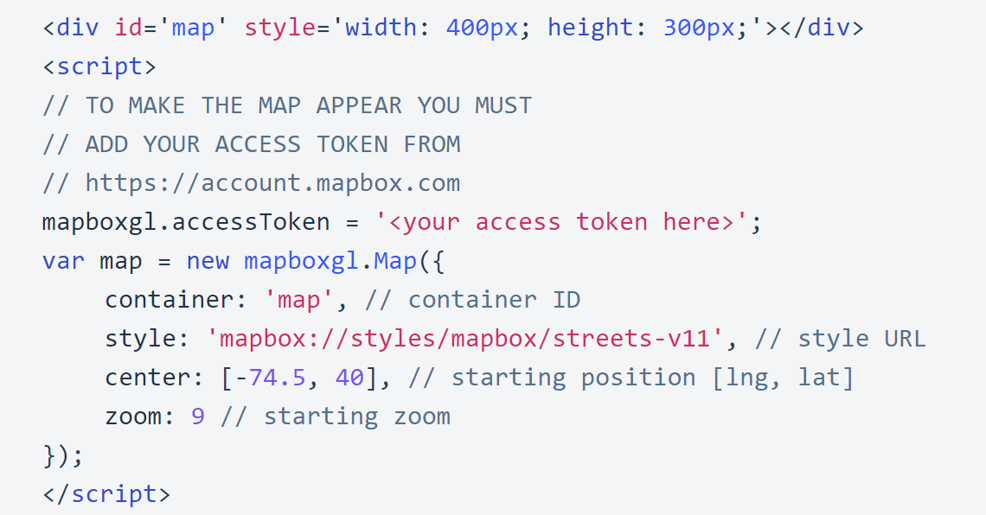
Mapbox GL JS
Mapbox GL JS is a JavaScript library that uses WebGL to render interactive maps from vector tiles and Mapbox styles.

Slide 11
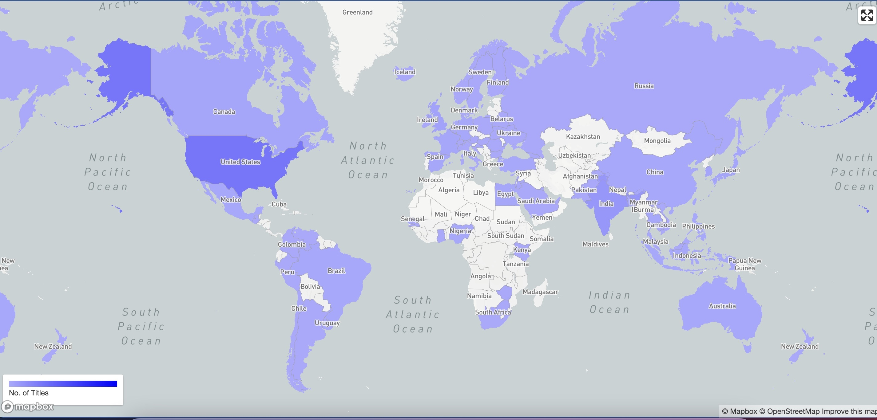

Slide 12
Thank You!!

